Slide 1


ICC HP Infrastructure
2013/04/09

Slide 2
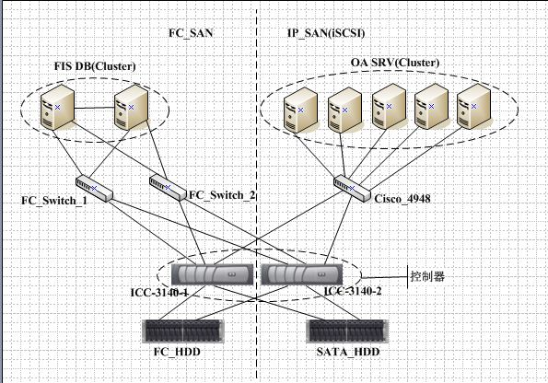
HP 系统架构

Slide 3

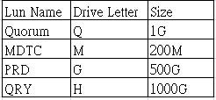
Current ICC DB Server Configuration 1、硬件信息 2、系统信息 3、Node1 存储信息
 | Node1 (Active)/Node2 (Passive)
CPU | 4*6 core (1.87G Hz)
Memory | 64G upgrade to 128 G for future
Windows OS | Windows 2003 64 bits
SQL Server | SQL 2005 64 bits
Domain | iccfis.inventec

Slide 4
Upgrade Case1- extension system
 | Node1 (Active) / Node2(Passive) | Node2 (Active)/ Node1 (Passive)
CPU | 4*6 core (1.87G Hz) | 4*6 core (1.87G Hz)
Memory | 64G | 64G
Windows OS | Windows 2003 64 bits | Windows 2003 64 bits
SQL Server | SQL 2005 64 bits | SQL 2005 64 bits
Domain | iccfis.inventec | iccfis.inventec
Node1
is old FIS DB primary node
Node2 is secondary
plan For TSB SQL Server after replacement
Node2
Is iMES HP DB primary node
Node1 is secondary
Repartition QRY Lun in SAN
Split Quorum/MSDTC/MasterData/Data/Log Lun in QRY
Impact
iMES function need modify
iMES used SQL 2008 SQL feature
Merge SQL
TVP (Type Valued Parameter) SQL

Slide 5
Upgrade Case2 – SQL Server
 | Node1 (Active) / Node2(Passive) | Node2 (Active)/ Node1 (Passive)
CPU | 4*6 core (1.87G Hz) | 4*6 core (1.87G Hz)
Memory | 64G | 64G
Windows OS | Windows 2003 64 bits | Windows 2003 64 bits
SQL Server | SQL 2005 64 bits | SQL 2008 R2 64 bits
Domain | iccfis.inventec | iccfis.inventec
Node1
old FIS DB primary node (SQL Server 2005 64 bits)
Node2 is secondary
plan for TSB SQL Server and upgrade SQL 2005 to 2008 after replacement
Node2
iMES HP DB primary node (SQL server 2008 64 bits)
Node1 is secondary
One node has installed different SQL Server version
Repartition QRY Lun in SAN
Split four Quorum/MSDTC/MasterData/Data/Log Luns in original QRY Lun
Impact
Cluster DB system is stable or not, because SQL version is not same in one node.

Slide 6
Upgrade Case3 – Fully upgrade (Used)
 | Node1 (Active) / Node2(Passive) | Node2 (Active)/ Node1 (Passive)
CPU | 4*6 core (1.87G Hz) | 4*6 core (1.87G Hz)
Memory | 64G (upgrade 128G ) | 64G (upgrade 128G )
Windows OS | Windows 2008 R2 64 bits | Windows 2008 R2 64 bits
SQL Server | SQL 2008 64 bits | SQL 2008 R2 64 bits
Domain | iccfis.inventec | iccfis.inventec
Node1
old FIS DB primary node
Node2 is secondary
plan for TSB SQL Server after replacement
Node2
iMES HP DB primary node
Node1 is secondary
Repartition SAN storage
Partition four Quorum/MSDTC/MasterData/Data/Log Luns per node
Impact
Need downtime to move old FIS Node1 DB to another DB server

Slide 7
Propose ICC Upgrade Solution
優先採用Case3 方案可以升級系統效能(重裝OS及SQL Server)
Node1 & Node2 OS:Windows 2008 R2
Node1 & Node2 SQL Server 是2008R2 +SP1
重新規劃SAN LUN
若產線無法停線遷移資料到外部的Stand alone 機器，建議採用Case 2 方案
Node1 & Node2 OS 是Windows 2003 64 bits 不變
Node 1 SQL Server 2005 (Active Mode) & Node2 SQL Server 2005 (Passive Mode)
Node2 SQL Server 2008R2 + SP1 (Active Mode) & Node1 SQL Server 2008 (Passive Mode)
重新規劃QRY LUN

Slide 8
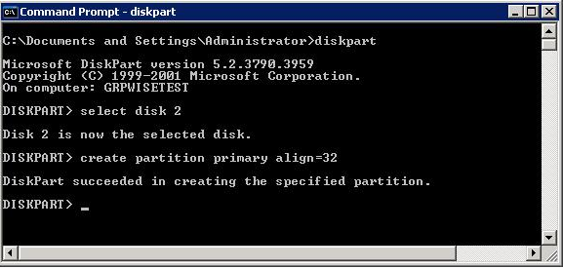
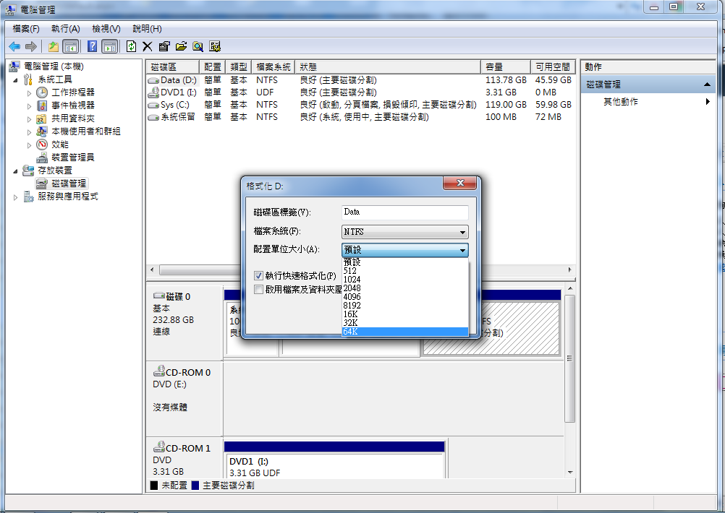
Partition SAN LUN
LUN Partition
LUN1 (1G)
Quorum (可以共用)
LUN2 (500MB)
MSDTC (可以共用)
LUN3 (200G) -- SQLMaster
tempdb\transaction log
master\model\msdb\distribution
LUN4 & LUN5 各 400G— SQLData1 & SQLData2
data\history\index\define
Disk Partition align is 64K
Windows 2003 Dos command:
Create Partition primary align=64
Windows 2008 可從UI 操作

Slide 9
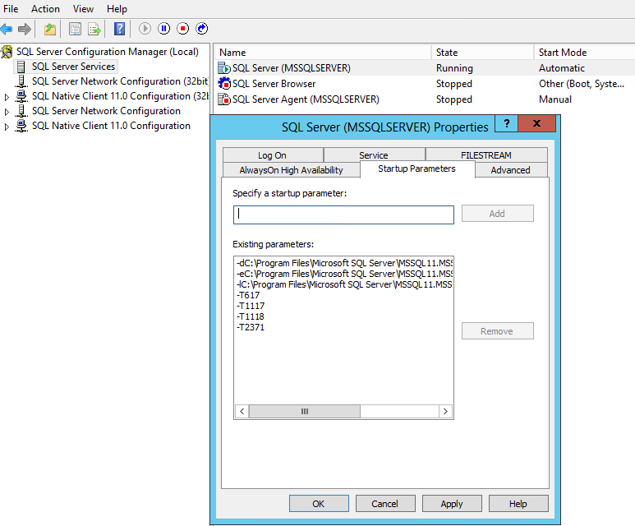
SQL Server File Group & Physical File
SQL Server File Group
PRIMARY Group
History Group
Index Group
Physical file
File 數*n= CPU core數, n=1,2,3,4……
跨SQLData1 & SQLData2 LUN
一個Group有6 files,一個LUN有 3個files
File初始化時，每個file自動增長空間設置一致
SQL Server 啟動參數: Trace flag 1117 (-T1117) can help keep data files the same size in case DB needs to autogrow.
啟動SQL Server Page compression 功能

Slide 10
Cluster Info
Node1: ICC-iMES-DB1
Public IP: 192.168.0.201/10.96.183.201
Node2: ICC-iMES-DB2
Public IP: 192.168.0.202/10.96.183.202
Windows Cluster IP :192.168.0.205/10.96.183.205
MSDTC IP: 192.168.0.206/10.96.183.206
IMESHPDB IP: 192.168.0.18/10.96.183.18
IMESTSBDB IP: 192.168.0.19/10.96.183.19 port:998
SQL SA_PSW: icc+123
User: iccfis\IEC990282 Psw: icc=123
AP Server:
AP1: 10.96.183.209
AP2: 10.96.183.210
NLB IP : 10.96.183.20

Slide 11
Cluster DB Server -- Partition SAN LUN
建置兩個Nodes for HP BU 跟 TSB 未來BU
每個Node 都安裝一套SQL Server 2008 R2 Cluster DB SQL Master，SQL Server 資料庫資料放置到SQL Data1/SQL Data2
LUN Name | Node1(For HP) | Node2(For TSB)
Quorum (共用) | LUN1(1G) | LUN1(1G)
MSDTC(共用) | LUN2(500M) | LUN2(500M)
SQL Master | LUN3(100G) | LUN3(100G)
SQL Data1 | LUN4(800G) | LUN4(500G)
SQL Data2 | LUN5(800G) | LUN5(500G)
SQL Log | LUN6(300G) | LUN6(300G)
BackUp Data | LUN7(300G) | LUN7(300G)
Query Data | LUN8(300G) | LUN8(300G)

Slide 12
ICC Cluster DB Server -- Partition SAN LUN
建置兩個Nodes for HP BU 跟 TSB 未來BU
每個Node 都安裝一套SQL Server 2008 R2 Cluster DB SQL Master，SQL Server 資料庫資料放置到SQL Data1/SQL Data2
新backup LUN 儲存定時完整備份及Transaction log備份資料
LUN Name | Node1(For HP) | Node2(For TSB)
Quorum (共用) | LUN1(1G) | LUN1(1G)
MSDTC(共用) | LUN2(500M) | LUN2(500M)
SQL Master | HPSQLMaster(200G) | TSBSQLMaster(200G)
SQL Data1 | HPSQLData1(550G) | TSBSQLData1(500G) for future
SQL Data2 | HPSQLData2(550G) | TSBSQLData2(500G) for future
SQL Backup | HPBackupData(500G) for future backup data | TSBBackupData(500G) for future backup data

Slide 13
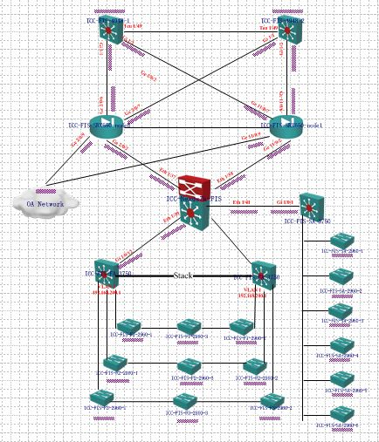
网络架构图

Slide 14
Cluster Server Heart Beat Check Item
1.Advanced TCP/IP Settings
WINS-No WINS, NetBIOS Setting-Disable NetBIOS over TCP/IP DNS-No DNS-Do Not Register Address in DNS IP Settings-No Gateway-Only IP Address and Subnet Mask Uncheck File and Printer Sharing for Microsoft Networks Uncheck Client for Microsoft Networks.
2.Cross-Over cables between two nodes can be used (Teaming is not supported but redundancy is recommended).
Network latency less than 500 ms is commonly accepted. Public network subnets should not be used here.
3.Adpater Link Speed and Duplex-avoid using Auto Negotiation Power Management-Uncheck.
4.Adapters & Bindings (order) Public Network Private Network.

Slide 15
Tuning SQL Server lock pages in Memory
Use startup options to lock pages in memory
A set of default startup options is written to the registry when SQL Server is installed, but these options can be overridden. For example, in SQL Server, locking pages for the buffers is supported by default in both SQL Server Enterprise Edition and Developer Edition, whereby the Windows operating system no longer pages out the buffer pool memory within the SQL Server process. However, the Windows operating system can still page out the non-buffer pool memory within the SQL Server process. For more information about this topic, see “Microsoft Knowledge Base Article 2659143,” available at support.microsoft.com/kb/2659143.
To enable the Lock Pages in Memory option, follow these steps:
1. Click Start > Run.
2. In the Open box, enter gpedit.msc.
3. From the Group Policy console, expand Computer Configuration > Windows
Settings > Security Settings > Local Policies.
4. Select the Users Rights Assignment checkbox. The policies are displayed in the details pane.
5. In the details pane, double-click Lock Pages in Memory.
6. In the Local Security Policy Setting dialog box, click Add.
7. In the Select Users or Groups dialog box, add an account with privileges to run sqlservr.exe.

Slide 16
SQL Server 2008 R2 -HD
Enable write caching on the log disk
The bigger the system, the greater the number of transactions and need for a cached log file for the database. The amount of data in the cached log file is proportional to the database. For example, on a Superdome, if the storage array is too slow to handle the array stream, you should enable write caching on the log drive.
As a rule of thumb, on a server with eight or more processors you need significantly more storage for the cached log file. Use an appropriate disk configuration tool to configure and enable the hardware cache.
To enable Write Caching on the log disk, follow these steps:
1. Right-click My Computer and select Manage.
2. Click Device Manager and expand Disk Drives.
3. Locate the log disk(s) and right-click each device entry. If you are using Secure Path or some other multi-path disk software, the correct disk may be a virtual device.
4. For each entry, right-click, select Properties, and click the Policies tab.
5. Verify the Optimize for performance radio button is selected.
6. Below that, verify that the Enable write caching on the disk and Enable advanced performance boxes are checked

Slide 17
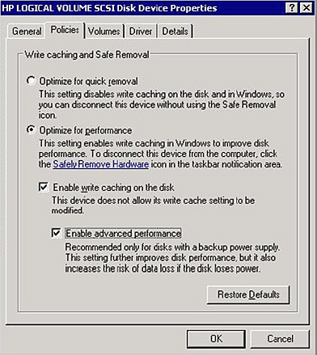
SQL Server 2008 R2 -HD

Slide 18
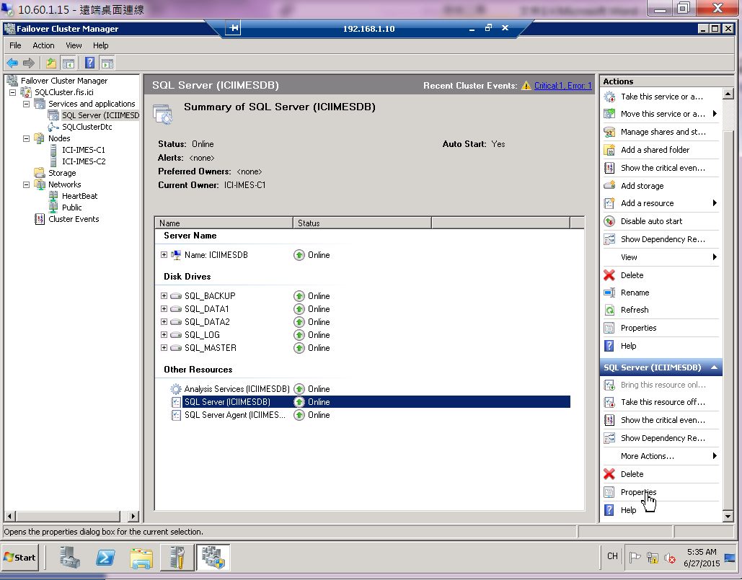
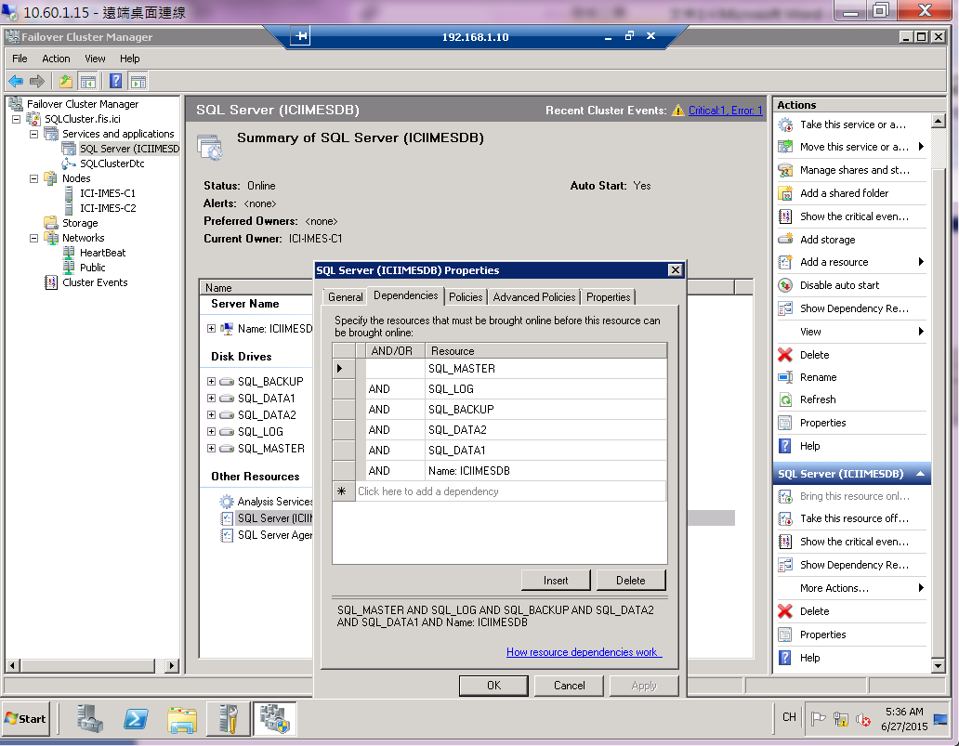
Cluster Server add Storage

Slide 19
Question and Answer
Thank You

Slide 20

DB Server Configuration 1、硬件信息 2、系统信息 3、存储信息

